Slide 1

Python Advanced

Slide 2


Program
Object-oriented programming
Classes, methods and attributes
Magic methods
Inheritance
Python Standard Library
Python Package Index

Slide 3
Recap
Python prompt
Executing a Python module
Variables
Operators
Built-in functions
Strings
Conditional statements
Loop statements
Data structures – Lists, Sets, Dicts
Comprehension
Functions – definition, arguments, return
Generators
Reading and writing files
Exceptions

Slide 4
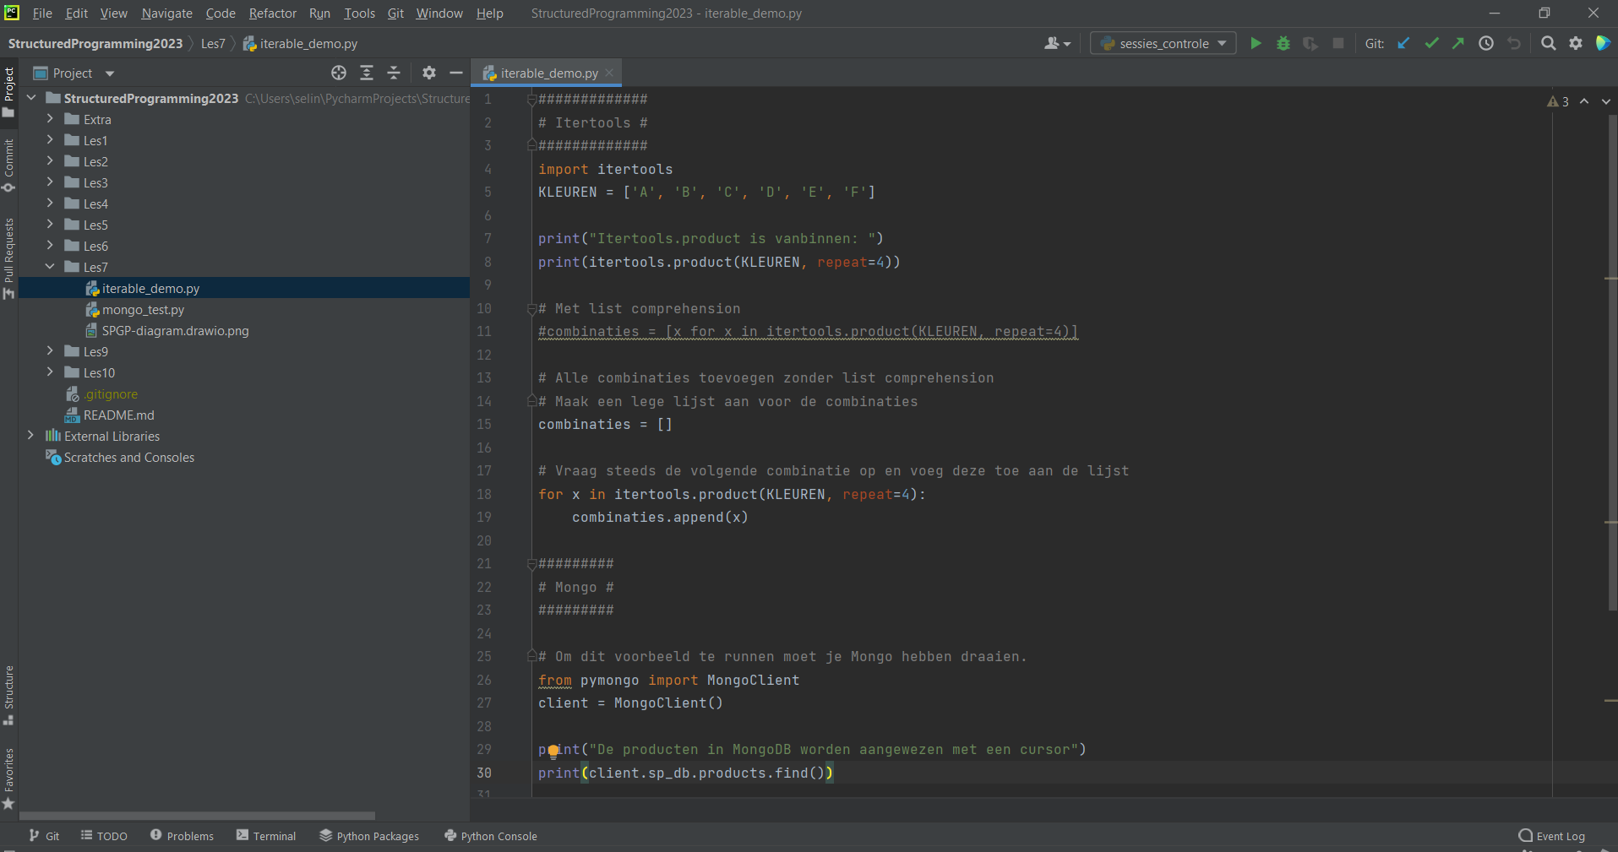
PyCharm
VCS integration
Execution
Project files
Editor
Notes:
Alle afbeeldingen op deze slide zijn intellectueel eigendom van CodeCafé.

Slide 5
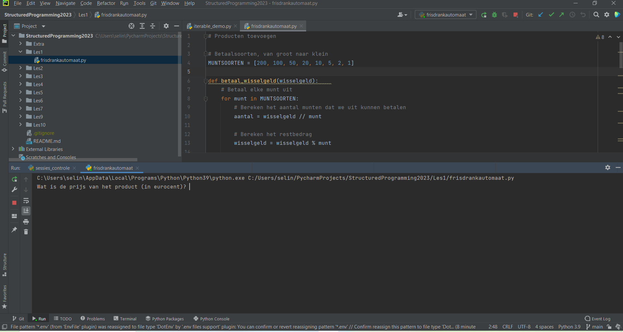
PyCharm
Execution
The terminal: where the magic happens!
Notes:
Alle afbeeldingen op deze slide zijn intellectueel eigendom van CodeCafé.

Slide 6
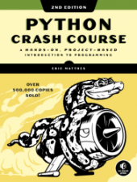
Book
Part I: Basics
Getting started
Variables and Simple Data Types
Introducing Lists
Working with Lists
If Statements
Dictionaries
User input and While Loops
Functions
Classes
Files and Exceptions
Testing Your Code
Part II: Projects
Project 1: Alien Invasion
Project 2: Data Visualization
Project 3: Web Applications
Resources:
https://ehmatthes.github.io/pcc_2e/regular_index/

Slide 7


Object-Oriented Programming
Class
?
Objects
?
Notes:
Afbeeldingen van Adobe Stock

Slide 8
Object-Oriented Programming
Class
Objects
Person
name
residence
attributes
tell()
move()
methods

Slide 9

Object-Oriented Programming
Class
instantiation
Objects
blueprint
instances
Person
name
residence
attributes
name: Peter
residence: Utrecht
tell()
move()
methods
name: Janneke
residence: Amsterdam
name: Kim
residence: Delft

Slide 10

Object-Oriented Programming
Class
instantiation
Objects
blueprint
instances
I am Peter and I live in Utrecht
I am Janneke and I live in Amsterdam
Person
name
residence
attributes
name: Peter
residence: Utrecht
tell()
move()
methods
name: Janneke
residence: Amsterdam
I am Kim and I live in Delft
tell()
name: Kim
residence: Delft
function call

Slide 11
Object-Oriented Programming
Class
Objects
blueprint
instantiation
instances
str
'something' → ‘SOMETHING’
attributes
upper()
lower()
split()
strip()
join()
title()
capitalize()
replace()
'something else' → ‘SOMETHING ELSE’
methods
'hello world' → ‘HELLO WORLD’
upper()
function call

Slide 12
Object-Oriented Programming
Class
Objects
blueprint
instantiation
instances
list
[2, 1, 3] → [1, 2, 3]
attributes
append()
insert()
extend()
pop()
sort()
[‘a’, ‘c’, ‘b’] → [‘a’, ‘b’, ‘c’]
methods
sort()
function call

Slide 13
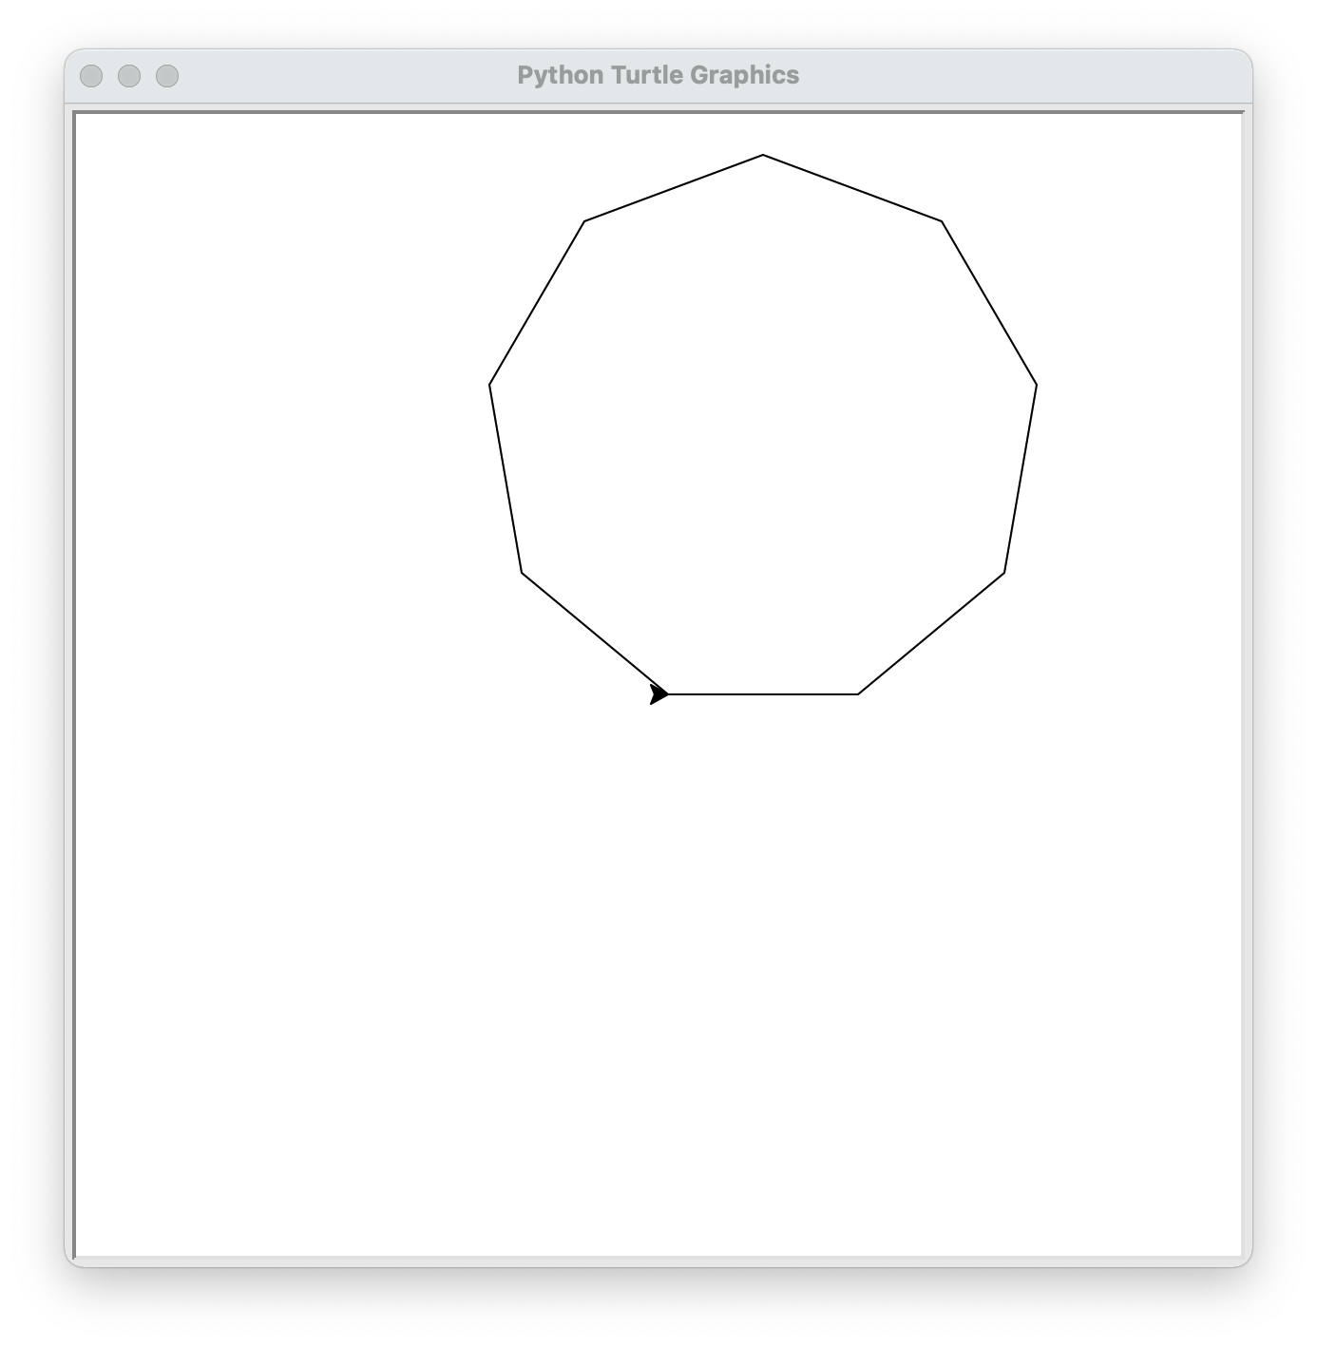
Exercise: Turtle
Draw a polygon with turtle.
Check out the different methods that you can use with turtle!
in particular: forward and left
Import the turtle library
Draw a polygon
Calculate the angle of each corner
Hint: https://en.wikipedia.org/wiki/Regular_polygon
Draw a square
End the program with turtle.done()

Slide 14
Classes
First define a class with the keyword class
Instantiate an object with the class
Set the state of the object by assigning values to the attributes
Call the methods of the object
Use the object operator . (a dot) to access attributes and methods
class Person:
pass
# --------------------------------
p = Person()
p.name = 'Albert'
p.residence = 'Amsterdam'

Slide 15
Methods
Methods are functions within a class. Methods can have arguments and a return statement just like normal functions.
The first argument is automatically set to the 'target' object. This is typically called self and refers to the object itself.
You can access the methods of a class using the object operator, which is the dot.
class Person:
def tell(self):
return f'I am f{self.name}'
# ------------------------------------------------------------
p = Person()
p.name = 'Albert'
print(p.tell())

Slide 16
Object initialization
When an object in created (instantiated) from a class the __init__ method is automatically called
__init__ is called a magic method. They are also called dunder methods for their double underscores.
There are so many more magic methods!
class Person:
def __init__(self, name):
self.name = name
def tell(self):
return(f'I am {self.name}')
# ------------------------------------------------------------
p = Person('Albert')
print( p.tell() )

Slide 17
Public or not
An attribute can be indicated as non-public by adding _ as a prefix to the name of the attribute.
This is more of a a guideline "We are all adults and know what we're doing."
You can add a double underscore __ to obstify de name of the attribute outside of the class. This is to prevent naming collissons when inheriting classes.
class Person:
def __init__(self, name):
self._name = name
def tell(self):
return(f'I am {self._name}')
# ------------------------------------------------------------
p = Person('Albert')
print( p.tell() )

Slide 18
Attributes
Attributes are typically initialized in the __init__ method
Attributes are dynamic and can be assigned a value anywhere
But this is not always the intention! (We’ll get back to that)
class Person:
def __init__(self, name, residence = 'unknown'):
self.__name = name
self.__residence = residence
def tell(self):
return(f'I am {self.__name} from {self.__residence}')
# ------------------------------------------------------------
p = Person('Albert', 'Amsterdam')
print(p.tell())

Slide 19
Exercise: Bank account
Create a BankAccount class, then create several BankAccount instantiations and demonstrate that you can deposit and withdraw an amount to the account.
Tips:
Create a class BankAccount first
Add attributes in the __init__ method. Attributes should be balance and holder.
Add the methods: deposit and withdraw that take an amount (in euros) argument and a third method info that returns information about the account.
Instantiate several BankAccount objects and write some code to demonstrate the capabilities of the class!

Slide 20
Exercise: Class Car
Create a class named Car
Add the __init__ method and set several attributes like make, type and color
Set the mileage attribute to 0
Create a method info that describes the car and the mileage
Create a method drive that takes an amount of kilometres and adds that to the mileage.
Test your class by instantiating a car and calling the methods
What happens when you drive a negative distance?

Slide 21
Class-wide attributes
Class wide attributes are attributes that are related to the class instead of to an object of that class.
Class wide attributes can be accessed by all objects of the class.
They do not use underscores.
class Mathematics:
pi = 3.14159
e = 2.71828
print( Mathematics.pi )
print( Mathematics.e )

Slide 22
Class-wide methods
Class-wide methods are methods related to the class.
A method can be indicated as a class-wide method with a decorator @classmethod or @staticmethod.
class Mathematics:
@staticmethod
def power1(x, n):
result = 1
for _ in range(n):
result *= x
return result
@classmethod
def power2(cls, x, n):
return cls.power1(x, n)
print(Mathematics.power1(2, 4))
print(Mathematics.power2(2, 4))
Notes:
Decorators

Slide 23
Example
class Person:
__slots__ = ('__name', '__residence')
def __init__(self, name, residence = 'unknown'):
self.__name = name
self.__residence = residence
def tell(self):
return('I am {} and I live in {}'\
.format(self.__name, self.__residence))
def move(self, new_residence):
self.residence = new_residence
p = Person('Albert', 'Amsterdam')
print(p.tell())
p.move('Eindhoven')
print(p.tell())

Slide 24
Magic Methods/Dunders
A class can have many different special methods.
Also called special methods.
A magic method is called by Python in all kind of situations, typically when operators & casting are used
__init__
__del__
__str__
__repr__ __int__ __float__
Objects
__eq__
__ne__ __lt__
__le__
__gt__
__ge__
__add__
__sub__
Operators
Casting

Slide 25
Exercise: Vector class
Create a 2D-Vector class. Also add operator overloading for the + sign to add two vectors together and to create a string representation.
Tips:
Build a class called Vector
Add two attributes: x and y
Implement the __init__ method that takes two arguments: x and y
Implement the __str__ method.
Implement the __add__ method the define the adding of two vectors.
Test your class by creating two vectors and adding these together.

Slide 26
Inheritance
Classes and functionality can be reused by using inheritance
The original class is called the parent class, the superclass or the base class
The new class is called the child class, the subclass or the derived class
Enclose the parent in parentheses after the new class name
All the attributes and methods of the parent class are available in the child class
In the __init__ method of the child class we always call the __init__ method of the parent class with the super method
class Vector(object):
class ChildClass(ParentClass):
def __init__(self, name):
super().__init__(name)

Slide 27
Exercise: Shapes
Create 3 classes, a parent class shape and two child classes circle and square
Tips:
Implement the __init__ method that takes the argument w and initialize attributes perimeter and surface
Implement the __str__ method.
Implement the method calc_perimeter and calc_surface that calculates those.
Implement the __eq__ and __lt__ methods to compare two shapes

Slide 28
Python Standard Library
The Python Standard Library consists of more than 200 modules and packages
The Python has "batteries included"
os
os.path
sys
string
re
math
random
datetime
calendar
csv
collections
array
decimal
fractions
statistics
pathlib
pickle
shelve
json
xml
sqlite3
zipfile
time
argparse
logging
threading
multiprocessing
subprocess
socket
asyncio
urllib
http
tkinter
doctest
unittest
timeit

Slide 29
sys - System-specific
System-specific parameters and functions
version
version_info
path
argv
exit
stdin / stdout / stderr
import sys
# get Python version
print(sys.version)
# add directory to sys.path
sys.path.append(r'c:\pythondev')

Slide 30
sys
Get the current version of Python
Return the message you are currently running Python version …

Slide 31
os - Operating system interfaces
The os.path module provides a portable way of using operating system dependent functionality.
rename
remove
mkdir
makedirs
chdir
getcwd
rmdir
listdir
path
pipe
scandir
walk
fork
exec
system
getenv
getpid
getppid
kill
wait
nice
import os
# set current working directory
os.chdir(r'c:\pythondev')
print(os.getcwd())

Slide 32
pathlib - Object-oriented filesystem paths
This module offers classes representing filesystem paths with semantics appropriate for different operating systems.
Path
PurePath
WindowsPath
PureWindowsPath
operator /
from pathlib import Path
p = Path('.')
list(p.glob('**/*.py'))

Slide 33
shutil
High-level file operations
copy
copytree
rmtree
move
disk_usage
chown

Slide 34
glob
The glob module finds all the pathnames matching a specified pattern according to the rules used by the Unix shell.
import glob
glob.glob('./file[0-9].*')

Slide 35
subprocess
The subprocess module allows you to spawn new processes, connect to their input/output/error pipes, and obtain their return codes.
run
import subprocess
subprocess.run(["ls", "-l"])
subprocess.run(["ls", "-l", "/dev/null"], capture_output=True)

Slide 36
tempfile
This module generates temporary files and directories.
It works on all supported platforms.
TemporaryFile
NamedTemporaryFile
TemporaryDirectory
import tempfile
with tempfile.TemporaryFile() as fp:
fp.write(b'Hello world!')
fp.seek(0)
fp.read()

Slide 37
os
Use the os library to get the contents of a directory in a list.

Slide 38
datetime - Basic date and time types
The datetime module supplies classes for manipulating dates and times.
class datetime.date
class datetime.time
class datetime.datetime
class datetime.timedelta
class datetime.tzinfo
class datetime.timezone
strftime
strptime
from datetime import datetime, date
datetime.strptime(s) d = date(2020, 2, 28)
print(d.strftime('%Y-%m-%d'))

Slide 39
datetime
input a date and print the date in another format

Slide 40
string - Common string operations
String methods
isnumeric
join
lower
replace
count
find
format
index
split
strip
title
# remove vowels
s = 'an example text'
vowels = "aeiou"
trans = str.maketrans("", "", vowels)
result = s.translate(trans)

Slide 41
re - Regular expression operations
Online: https://www.regex101.com/#python
search(pattern, string, flags)
match(pattern, string, flags)
findall(pattern, string, flags)
sub(pattern, repl, string, max=0, flags)
compile(pattern)
import re
match = re.search(r'@([\w\.]+)\b', 'albert@gmail.com', re.I)
if match:
for group in match.groups():
print('Domain: ', group)

Slide 42
re
Go to the website https://rubular.com
Build and test a regular expression to match an e-mail address
Use the same regular expression in python with the search method in the re library

Slide 43
math - Mathematical functions
pi
e
acos
acosh
asin
asinh
atan
atan2
atanh
ceil
copysign
cos
cosh
degrees
erf
erfc
exp
expm1
fabs
factorial
floor
fmod
frexp
fsum
gamma
gcd
hypot
inf
isclose
isfinite
isinf
isnan
ldexp
lgamma
log
log10
log1p
log2
modf
nan
pow
radians
remainder
sin
sinh
sqrt
tan
tanh
tau
trunc

Slide 44
random - Pseudo-random numbers
Generate pseudo-random numbers
random.seed()
random.randrange(start, stop)
random.randint(a, b)
random.choice(sequence)
random.choices(sequence, k=1)
random.shuffle(sequence)
random.sample(sequence, n)
random.random()
import random
items = 'abcdefghiklmnopqrstuwvxyz0123456789'
sample = random.sample(items, 3)

Slide 45
json - JavaScript Object Notation
json.dump(object, file)
json.dumps(object)
json.load(file)
json.loads(string)
JSON encoder and decoder
import json
s = json.dumps([1,2,3,{'4': 5, '6': 7}])
with open('bestand.json', 'w') as f:
json.dump([1,2,3,{'4': 5, '6': 7}], f)
json.loads('[1,2,3,{"4":5,"6":7}]')

Slide 46
pickle - Python object serialization
A shelf is a persistent, dictionary-like object that stores any arbitrary Python that can be pickled.
pickle.dump(object, file)
pickle.dumps(object)
pickle.load(file)
pickle.loads(string)
import pickle
class User: def saveToPickle(self):
with open('user.pickle','wb') as f:
pickle.dump(self, f)
def loadFromPickle(self):
with open('user.pickle','rb') as f:
self.__dict__.update(pickle.load(f).__dict__)
@classmethod
def createFromPickle(cls):
with open('user.pickle','rb') as f:
return pickle.load(f)

Slide 47
pickle
Create a datastructure and store this in a pickle file. Create a second python script that reads pickle file and restores the data in the data structure.

Slide 48
xml
The xml.etree.ElementTree module implements a simple and efficient API for parsing and creating XML data.
This module provides limited support for XPath expressions for locating elements in a tree. https://www.w3schools.com/xml/xpath_intro.asp
ElementTree provides a simple way to build XML documents and write them to files.
import xml.etree.ElementTree as ET
tree = ET.parse('data.xml')
root = tree.getroot()
print(root.attrib)
for element in root.findall('//name'):
print(element.text)

Slide 49
xml
Read the Macbeth xml file and generate several overviews.
The name of the play
The names of all the personas
The names of all the scenes
import xml.etree.ElementTree as ET
tree = ET.parse('data.xml')
root = tree.getroot()
print(root.attrib)
for element in root.findall('//name'):
print(element.text)

Slide 50
statistics
This module provides functions for calculating mathematical statistics of numeric (Real-valued) data.
pstdev
pvariance
stdev
variance
bisect_left
bisect_right
collections
groupby
harmonic_mean
mean
median
median_grouped
median_high
median_low
mode
numbers
statistics
import statistics numbers = [23, 64, 86, 23, 54, 76, 98, 21]
print('Median:', statistics.median(numbers))
print('Mean:', statistics.mean(numbers))
print('St.Dev.:', statistics.stdev(numbers))

Slide 51
Statistics
Create a function that calculates and returns the mean, median and mode of a list of numbers.
Tips:
Define a function as def central_measures(numbers)
Calculate the measures:
The mean is the sum of the values divided by the number of values
The median is middle value of the sorted list of values
The mode is the most frequently occuring value
Return the measures as a tuple with return mean, median, mode
Call the function with a list of arbitrary numbers
Print the result

Slide 52
doctest
The doctest module searches for pieces of text that look like interactive Python sessions, and then executes those sessions to verify that they work exactly as shown.
def square(n):
"""Calculate the square of n.
>>> [square(n) for n in range(6)]
[0, 1, 4, 9, 16, 25]
"""
return n ** 2
if __name__ == "__main__":
import doctest
doctest.testmod(verbose=True)

Slide 53
doctest
Create a function and add a docstring with doctests for the function.

Slide 54
unittest - Unit testing framework
assertEqual(a, b)
assertNotEqual(a, b)
assertTrue(x)
assertFalse(x)
assertIs(a, b)
assertIsNot(a, b)
assertIsNone(x)
assertIsNotNone(x)
assertIn(a, b)
assertNotIn(a, b)
assertIsInstance(a, b)
assertNotIsInstance(a, b)
There is also an assert statement
import unittest
class TestStringMethods(unittest.TestCase):
def test_upper(self):
self.assertEqual('foo'.upper(), 'FOO')
def test_isupper(self):
self.assertTrue('FOO'.isupper())
self.assertFalse('Foo'.isupper())
if __name__ == '__main__':
unittest.main()

Slide 55
csv – Comma Seperated Values
CSV File Reading and Writing
reader
writer
DictReader
DictWriter
import csv
filename = 'data.csv'
with open(filename) as f:
reader = csv.DictReader(f, delimiter=';')
for row in reader:
print(row['first_name'], row['last_name'])

Slide 56
decimal
The decimal module provides support for fast correctly-rounded decimal floating point arithmetic.
from decimal import Decimal
d1 = Decimal('0.1')
d2 = Decimal('0.2')
result = float(d1 + d2)

Slide 57
fractions
The fractions module provides support for rational number arithmetic.
from fractions import Fraction
d1 = Fraction(1, 3) # => 1/3
d2 = Fraction(1, 2) # => 1/2
result = d1 + d2 # => 5/6

Slide 58
sqlite3
DB-API 2.0 interface for SQLite databases
PEP 249 - Database API Specification 2.0
import sqlite3
conn = sqlite3.connect('example.db')
c = conn.cursor()
c.execute("""CREATE TABLE stocks
(date text, trans text, symbol text, qty real, price real)""")
c.execute("""INSERT INTO stocks
VALUES ('2006-01-05’, 'BUY’, 'RHAT’, 100, 35.14)""")
conn.commit()
for row in c.execute('SELECT * FROM stocks ORDER BY price'):
print(row)
conn.close()

Slide 59
Concurrency
concurrency
multiprocessing
threading
asynchronous IO
Python Standard Library:
multiprocessing package
threading package
asyncio package and async/await keywords (introduced in Python 3.4)

Slide 60
Comparison
 | Multiprocessing | Threading | Asynchronous IO
Package | multiprocessing | threading | asyncio
Class | Proces | Thread | Coroutine
Python | Class Proces | Class Thread | Keywords async, await
Data sharing | Message | Shared data
Usage | CPU intensive | IO intensive | IO intensive

Slide 61
Proces versus Thread
True parallelism in Python is achieved by creating multiple processes, each having a Python interpreter with its own separate GIL.
Process | Thread
processes run in separate memory (process isolation) | threads share memory
uses more memory | uses less memory
children can become zombies | no zombies possible
more overhead | less overhead
slower to create and destroy | faster to create and destroy
easier to code and debug | can become harder to code and debug

Slide 62
Python GIL
A global interpreter lock (GIL) is a mechanism used in Python interpreter to synchronize the execution of threads so that only one native thread can execute at a time, even if run on a multi-core processor.
The C extensions, such as numpy, can manually release the GIL to speed up computations. Also, the GIL released before potentionally blocking I/O operations.
Note that both Jython and IronPython do not have the GIL.

Slide 63
threading - Thread-based parallelism
Thread
start
run
join
name
active_count
current_thread
main_thread
import time
from threading import Thread
def myfunc(i):
print "sleeping 5 sec from thread %d" % i
time.sleep(5)
print "finished sleeping from thread %d" % i
for i in range(10):
t = Thread(target=myfunc, args=(i,))
t.start()

Slide 64
asyncio
At the heart of async IO are coroutines. A coroutine is a specialized version of a Python generator function.
import asyncio
async def count():
print("One")
await asyncio.sleep(1)
print("Two")
async def main():
await asyncio.gather(count(), count(), count())
if __name__ == "__main__":
import time
s = time.perf_counter()
asyncio.run(main())
elapsed = time.perf_counter() - s
print(f"{__file__} executed in {elapsed:0.2f} seconds.")

Slide 65
multiprocessing
The multiprocessing library is based on spawning Processes.
A process starts a fresh Python interpreter thereby side-stepping the Global Interpreter Lock
The multiprocessing module allows the programmer to fully leverage multiple processors on a given machine.
from multiprocessing import Process def f(name): print('hello', name) if __name__ == '__main__': p = Process(target=f, args=('bob',)) p.start() p.join()

Slide 66
logging - Logging facility for Python
Setup with basicConfig
Logging Levels: DEBUG, INFO, WARNING, ERROR, CRITICAL
import logging
logging.basicConfig(
filename = None, # or to a file 'example.log',
level = logging.ERROR,
format = '%(asctime)s.%(msecs)03d - %(message)s',
datefmt = '%Y-%m-%dT%H:%M:%S')
logging.debug('This message should go to the log file')
logging.info('So should this')
logging.warning('And this, too') logging.error('Watch out!') logging.critical('ERROR!!!!!')

Slide 67
timeit
Measure execution time of small code snippets.
from timeit import timeit
timeit('"-".join(str(n) for n in range(100))', number=10000)
timeit(lambda: "-".join(map(str, range(100))), number=10000)

Slide 68
zipfile
The ZIP file format is a common archive and compression standard. This module provides tools to create, read, write, append, and list a ZIP file.
import zipfile
import pandas as pd
with zipfile.ZipFile("FinalExam.zip") as z:
with z.open("AdvWorksCusts.csv") as f:
df_Customers = pd.read_csv(f)
with z.open("AW_AveMonthSpend.csv") as f:
df_AveMonthSpend = pd.read_csv(f)
with z.open("AW_BikeBuyer.csv") as f:
df_BikeBuyer = pd.read_csv(f)

Slide 69
tarfile
The tarfile module makes it possible to read and write tar archives, including those using gzip, bz2 and lzma compression.
import tarfile
t = tarfile.open('example.tar.gz', 'r')
print("Files in TAR file:")
print(t.getnames())

Slide 70
GUI Frameworks
TkInter - The traditional Python user interface toolkit.
PyQt - Bindings for the cross-platform Qt framework.
PySide - PySide is a newer binding to the Qt toolkit
wxPython - a cross-platform GUI toolkit that is built around wxWidgets
Win32Api - native window dialogs
PyMsgBox

Slide 71
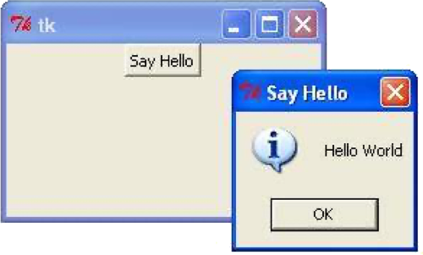
tkinter
The tkinter package (“Tk interface”) is the standard Python interface to the Tk GUI toolkit.
There are also Standard Dialogs
import tkinter as tk
import tkMessageBox
top = tk.Tk()
def hello():
tkMessageBox.showinfo("Say Hello", "Hello World")
btn1 = tk.Button(top, text = "Say Hello", command = hello)
btn1.pack()
top.mainloop()

Slide 72
The Python Package Index - PyPI
The official third-party software repository for the Python programming language
The Python Package Index is a repository of software for the Python programming language. There are currently > 300000 packages.
Install packages with the pip command.
pip list
pip search
pip install numpy
pip install scipy
pip install matplotlib
pip install pandas
pip install requests
pip install pyodbc

Slide 73
Virtual Environment
Seperated enviroments
Requirements file
$ virtualenv –p python3.5 venv
$ . venv/bin/activate
$ pip list > requirements.txt
$ pip install -r requirements.txt

Slide 74
pyodbc - Accessing ODBC databases
import pyodbc
conn = pyodbc.connect(
'DRIVER={SQL Server};'
'SERVER=localhost\SQLEXPRESS;'
'DATABASE=mijndatabase;'
'UID=username; PWD=pa55w0rd')
sql = 'SELECT customers.* FROM customers'
cursor = conn.cursor()
for row in cursor.execute(sql):
print("{}, {}".format(row.name, row.residence)
cursor.close()
conn.close()
PEP 249 -- Python Database API Specification v2.0

Slide 75
numpy
NumPy is the fundamental package for scientific computing with Python.
NumPy's main object is the homogeneous multidimensional array.
Vectorized operations
import numpy as np
a = np.array([1,2,3,4])
b = np.array( [ (1.5,2,3), (4,5,6) ] )
c = np.narray( [ [1,2], [3,4] ], dtype=complex )
np.zeros( (3,4) )
np.arange( 0, 2, 0.4 ) # array([ 0., 0.4, 0.8, 1.2, 1.6, 2.0])
np.linspace( 0, 2*pi, 100 ). # 100 numbers from 0 to 2*pi

Slide 76
scipy
Clustering
Constants
Discrete Fourier transforms
Integration
Interpolation
Input and output
Linear algebra
Miscellaneous routines
Multi-dimensional image processing
Orthogonal distance regression
Optimization and Root Finding
Signal processing
Sparse matrices
Sparse linear algebra
Compressed Sparse Graph Routines
Spatial algorithms and data structures
Special functions
Statistical functions
Statistical functions for masked arrays
Low-level callback functions
It provides many user-friendly and efficient numerical routines, such as routines for numerical integration, interpolation, optimization, linear algebra, and statistics.

Slide 77
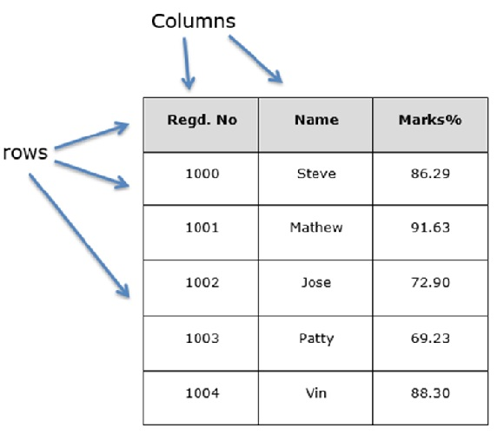
pandas
Pandas is a fast, powerful, flexible and easy to use open source data analysis and manipulation tool.
Series is a one-dimensional labeled array capable of holding any data type
DataFrame is a 2-dimensional labeled data structure with columns of potentially different types.
https://pandas.pydata.org/docs/getting_started/10min.html#min

Slide 78
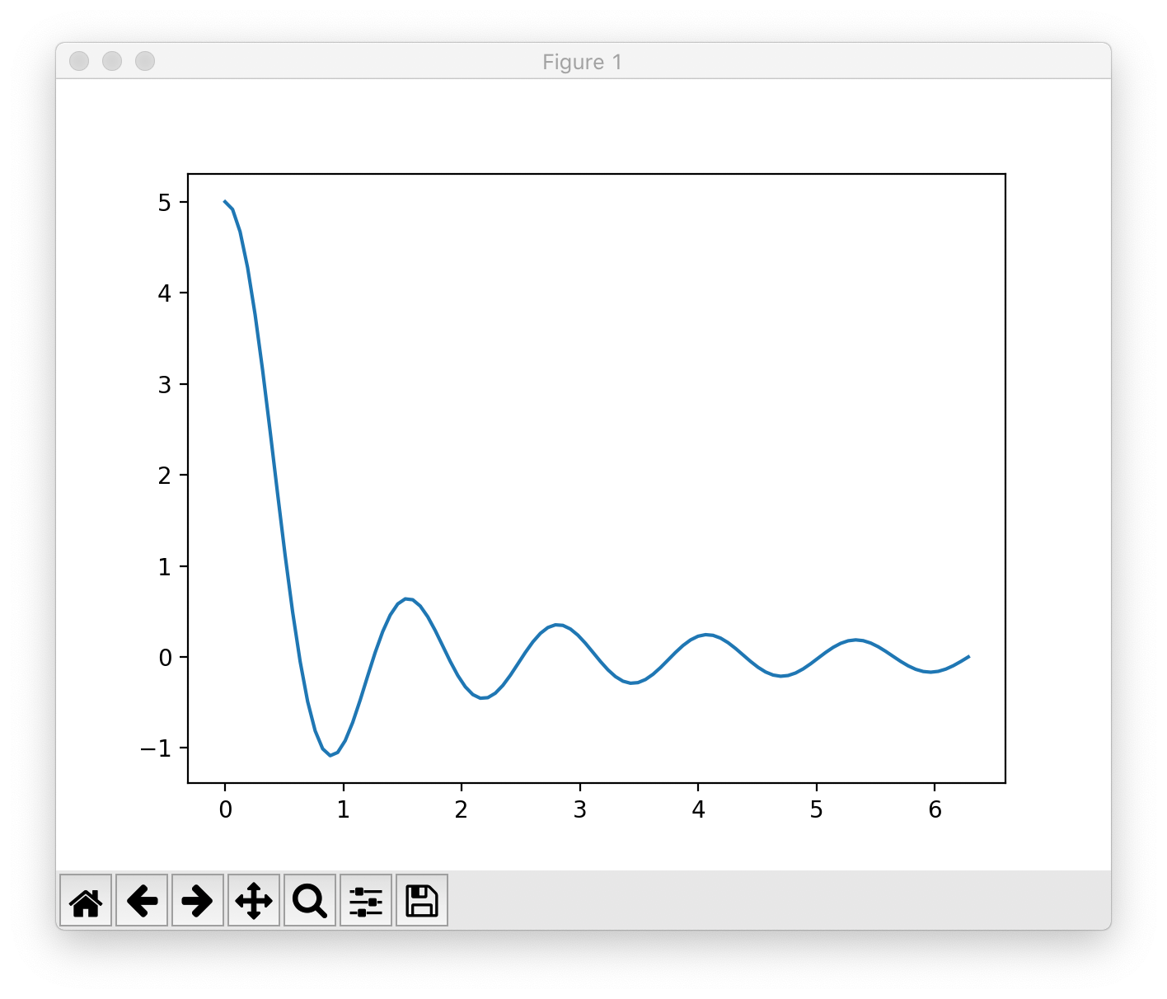
matplotlib
Matplotlib is a Python 2D plotting library which produces publication quality figures
3D plot
Image plot
Contour plot
Polar plot
Line plot
Histogram
Scatter plot
import matplotlib.pyplot as plt
import numpy as np
x = np.linspace( 0.000001, 2*np.pi, 100 )
y = 1/x * np.sin(5*x)
plt.plot(x, y)
plt.show()

Slide 79
Matplotlib
Write a Python program to draw a line with suitable label in the x axis, y axis and a title.
Write a Python program to display the grid and draw line charts of the closing value of Alphabet Inc. between October 3, 2016 to October 7, 2016. Customized the grid lines with linestyle -, width .5. and color blue:
Date,Close
03-10-16,772.559998
04-10-16,776.429993
05-10-16,776.469971
06-10-16,776.859985
07-10-16,775.080017

Slide 80
Get the weather in New York
Use requests to query openweathermap.org for the weather in a specified city.
Tips:
import requests
build the url (see https://openweathermap.org/current) use: appid=d1526a9039658a6f76950cff21823aff
use the following code to get the response: response = requests.get(url)
use json to decode the response into a Python dictionary
response.json()
get and print the temperature

Slide 81
requests – HTTP for Humans
Requests is an elegant and simple HTTP library for Python, built for human beings.
import requests
url = "http://api.openweathermap.org/data/2.5/weather"
url += "?appid=d1526a9039658a6f76950cff21823aff"
url += "&units=metric"
url += "&mode=json"
url += "&q=New York"
response = requests.get(url)
if (response.status_code == 200):
body = response.text
decoded = response.json() temperature = decoded['main']['temp']
else:
print("Error for city %s" % (city))

Slide 82
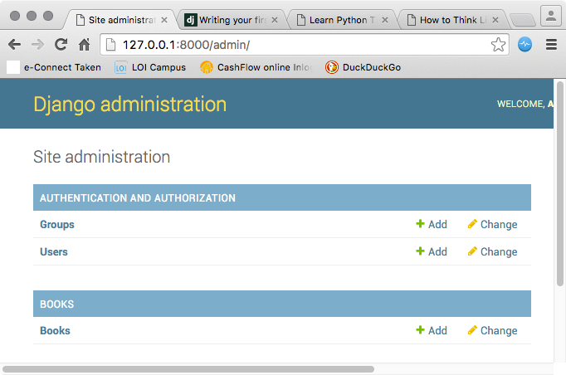
django
MVC Framework
Models
Object-Relational Mapping
URL Mapping
Views
HTML Templates
Command line bootstrap:
$ mkdir django-demo
$ cd django-demo
$ virtualenv -p python3.5 venv
$ . venv/bin/activate
$ pip install django
$ django-admin
$ django-admin startproject demo
$ python manage.py createsuperuser
$ python manage.py startapp books
$ python manage.py makemigrations
$ python manage.py migrate
$ python manage.py runserver

Slide 83
Python Distributions
Anaconda
Active Python
Python (X,Y)
IPython
Enthought Canopy
Sage
PyPy
Pocket Python
Portable Python

Slide 84
Implementations
CPython reference implementation
IronPython (Python running on .NET)
Jython (Python running on the Java Virtual Machine)
PyPy (A fast python implementation with a JIT compiler)
Stackless Python (Branch of CPython supporting microthreads)
MicroPython (Python running on micro controllers)

Slide 85
Style Guide for Python Code
PEP 8 - Style Guide for Python Code
Notes:
Python Enhancement Proposals (PEPs)

Slide 86
Ducktyping
“If it looks like a duck and quacks like a duck, it must be a duck.”
A programming style which does not look at an object’s type to determine if it has the right interface; instead, the method or attribute is simply called or used

Slide 87
EAFP versus LBYL
EAFP: "it's easier to ask for forgiveness than permission
LBYL: "look before you leap"

